Slide 1
MACHINE LEARNING MODEL ANALYSIS
CURRENT MODEL
REFINED MODEL APPROACH
ONLINE LEARNING
MEDICAL TEST MODEL
GEOLOCATION CLUSTERING
CORE AI

Slide 2
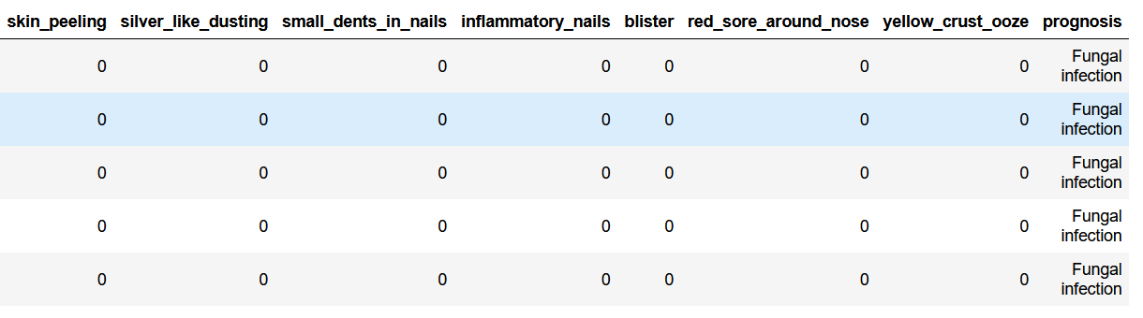
CURRENT MODEL
DATASET INFORMATION-
COLUMNS- 133
ROWS - 4920
TARGET COLUMN - ‘PROGNOSIS’
DATASET

Slide 3
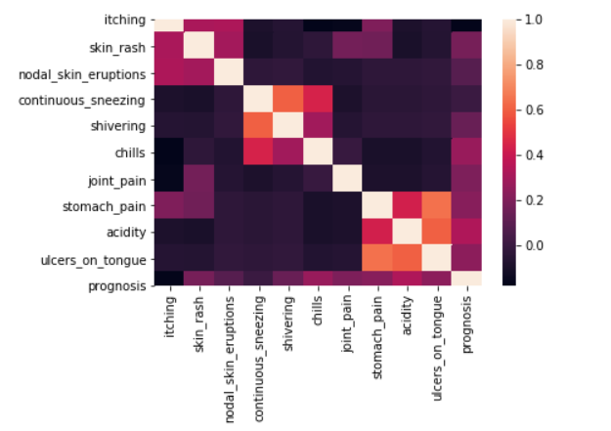
CURRENT MODEL
Performed data analysis and data preprocessing
Trained several classification model for choosing the best algorithm according to our requirement with the help of metrics and probability.

Slide 4
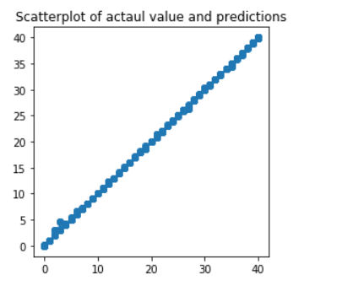
CURRENT MODEL
Algorithms Selected –
1. Random Forest Classifier
2. Stochastic Gradient Descent
3. MultiNomial Naïve Bayes
4. Multi Layer Perceptron

Slide 5
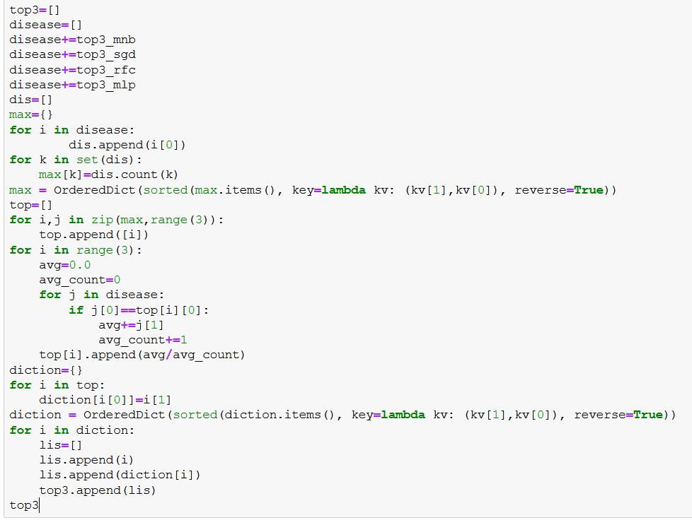
CURRENT MODEL
Logic used for extracting top 3 diseases from 4 models.

Slide 6
REFINED MODEL APPROACH
In the refined model approach, we will more features on the basis of severity of symptoms and classify them age wise.
Algorithmic View
Random Forest Classifier
Age wise
Fever
low
medium
high
Group 1
Group 2
Group 3
Disease 2
Disease 1

Slide 7
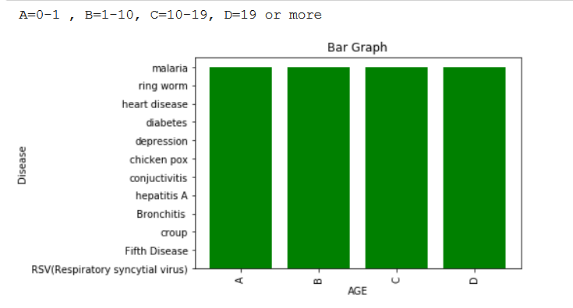
REFINED MODEL APPROACH
We have created a synthetic dataset for predicting the disease age wise and with severity of symptoms.
This bar graph shows diseases occurrence age wise.
Currently we are working on this refined model and it will be the addition of our current model with more features.

Slide 8
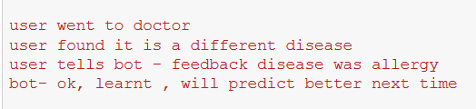
ONLINE LEARNING
In online learning approach, model is updated to adapt the new data.
Feedback feature will be included in the chat bot for taking the information about diagnosis done by doctor.
Model will learn from its mistakes and will predict better next time.

Slide 9



ONLINE LEARNING
Implementation Approach
We will use “partial_fit” method for training that instance to existing model.
Sklearn, it don’t provide partial fit method for random forest classifier.
So, we can use another library “crème” which is developed by a research scholar.
Multinomial Naïve Bayes
SGD classifier
Multilayer Perceptron
Random Forest Classifier

Slide 10
MEDICAL TEST MODEL
We can even provide tests suggestions based on symptoms and diseases.
Testing model will be included after diseases prediction.
We can verify and validate test suggestions with the help of domain expert and hospitals.
Testing examples
Disease clinical test
1. Hepatitis B : Hepatitis B surface antigen test
2. Hepatitis C: Antibodies to HCV test
3. HIV: Antibodies to HIV test
4. Malaria: Plasmodium spp. antigens test
5. Tuberculosis: Mycobacterium tuberculosis bacteria test
6. syphilis: antibodies to Treponema pallidum test.

Slide 11
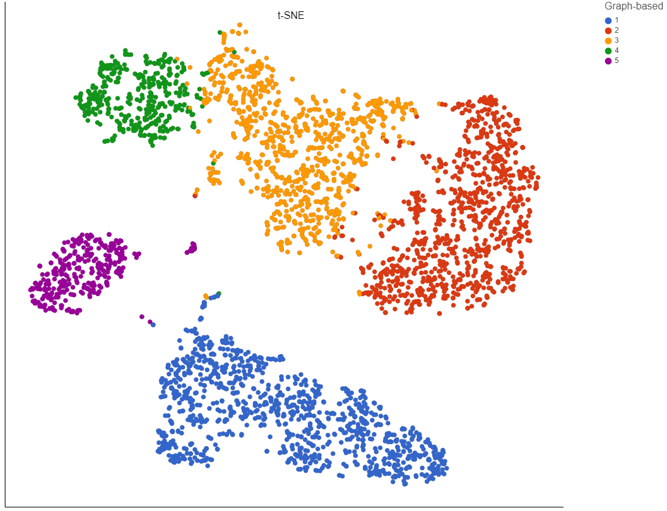
GEOLOCATION CLUSTERING
Cluster diseases and symptoms based on the location with the help of machine learning clustering algorithms and after this, bot can suggest users to be alert of those diseases and can even provide proper precautions .

Slide 12
CORE AI of Chat bot
Geolocation clustering
Prediction with logic
MLP classifier
MN naïve bayes
SGD classifier
Random Forest
Refined Model
Medical test Model

